Slide 1
Module 14: Transport Layer
Introduction to Networks v7.0 (ITN)

Slide 2
14.1 Transportation of Data
Notes:
14 –Transport Layer
14.1 - Transportation of Data

Slide 3
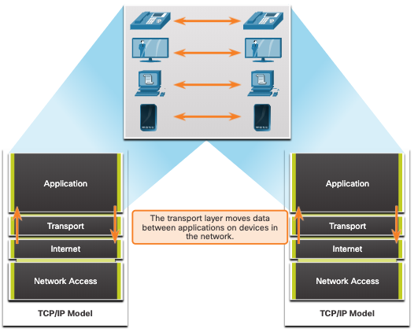
Transportation of Data Role of the Transport Layer
The transport layer is:
responsible for logical communications between applications running on different hosts.
The link between the application layer and the lower layers that are responsible for network transmission.
Notes:
14 –Transport Layer
14.1 - Transportation of Data
14.1.1 – Role of the Transport Layer

Slide 4
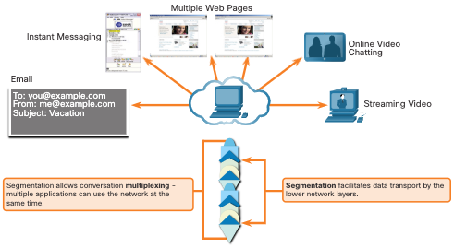
Transportation of Data Transport Layer Responsibilities
The transport layer has the following responsibilities:
Tracking individual conversations
Segmenting data and reassembling segments
Adds header information
Identify, separate, and manage multiple conversations
Uses segmentation and multiplexing to enable different communication conversations to be interleaved on the same network
Notes:
14 –Transport Layer
14.1 - Transportation of Data
14.1.2 – Transport Layer Responsibilities

Slide 5
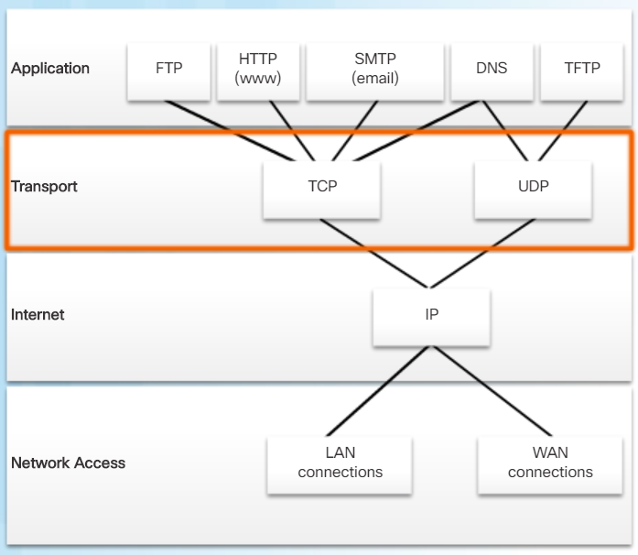
Transportation of Data Transport Layer Protocols
IP does not specify how the delivery or transportation of the packets takes place.
Transport layer protocols specify how to transfer messages between hosts, and are responsible for managing reliability requirements of a conversation.
The transport layer includes the TCP and UDP protocols.
Notes:
14 –Transport Layer
14.1 - Transportation of Data
14.1.3 – Transport Layer Protocols

Slide 6
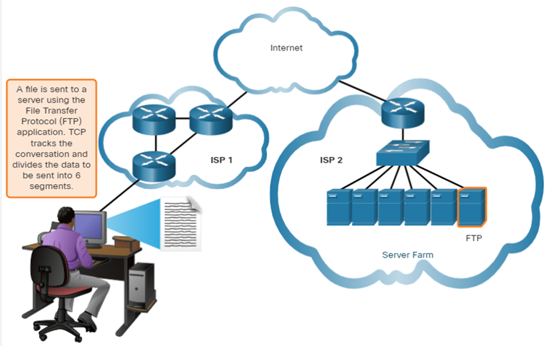
Transportation of Data Transmission Control Protocol
TCP provides reliability and flow control. TCP basic operations:
Number and track data segments transmitted to a specific host from a specific application
Acknowledge received data
Retransmit any unacknowledged data after a certain amount of time
Sequence data that might arrive in wrong order
Send data at an efficient rate that is acceptable by the receiver
Notes:
14 –Transport Layer
14.1 - Transportation of Data
14.1.4 – Transmission Control Protocol (TCP)

Slide 7
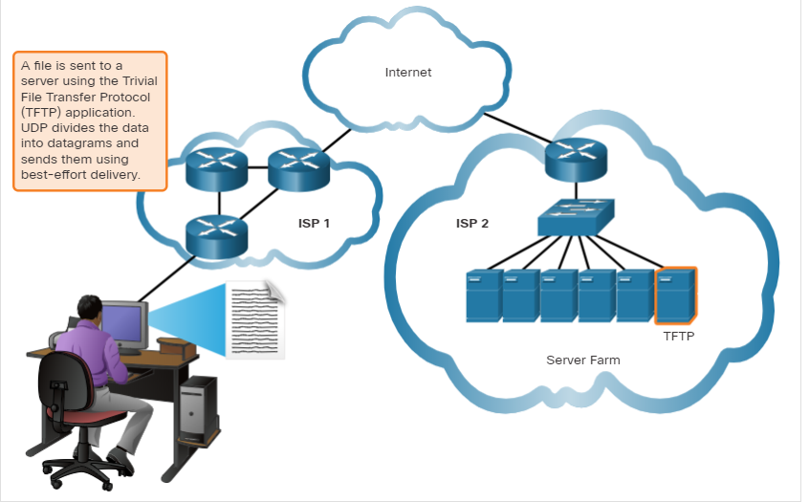
Transportation of Data User Datagram Protocol (UDP)
UDP provides the basic functions for delivering datagrams between the appropriate applications, with very little overhead and data checking.
UDP is a connectionless protocol.
UDP is known as a best-effort delivery protocol because there is no acknowledgment that the data is received at the destination.
Notes:
14 –Transport Layer
14.1 - Transportation of Data
14.1.5 – User Datagram Protocol (UDP)

Slide 8
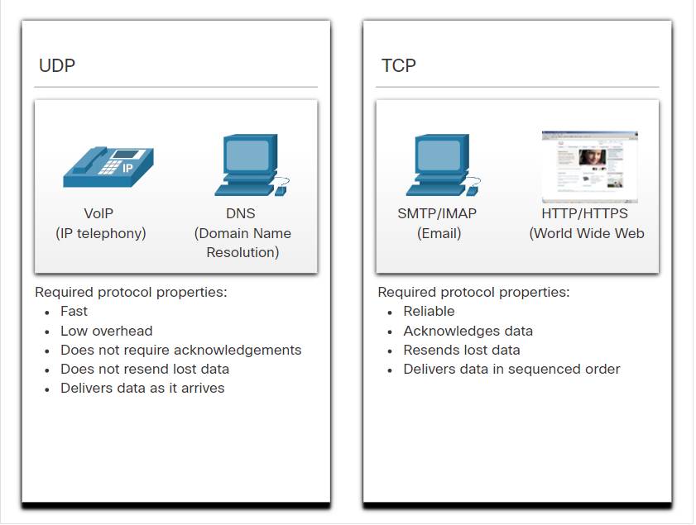
Transportation of Data The Right Transport Layer Protocol for the Right Application
UDP is also used by request-and-reply applications where the data is minimal, and retransmission can be done quickly.
If it is important that all the data arrives and that it can be processed in its proper sequence, TCP is used as the transport protocol.
Notes:
14 –Transport Layer
14.1 - Transportation of Data
14.1.6 – The Right Transport Layer Protocol for the Right Application
14.1.7 – Check your Understanding- Transportation of Data

Slide 9
14.2 TCP Overview
Notes:
14 – Transport Layer
14.2 – TCP Overview

Slide 10
TCP Overview TCP Features
Establishes a Session - TCP is a connection-oriented protocol that negotiates and establishes a permanent connection (or session) between source and destination devices prior to forwarding any traffic.
Ensures Reliable Delivery - For many reasons, it is possible for a segment to become corrupted or lost completely, as it is transmitted over the network. TCP ensures that each segment that is sent by the source arrives at the destination.
Provides Same-Order Delivery - Because networks may provide multiple routes that can have different transmission rates, data can arrive in the wrong order.
Supports Flow Control - Network hosts have limited resources (i.e., memory and processing power). When TCP is aware that these resources are overtaxed, it can request that the sending application reduce the rate of data flow.
Notes:
14 – Transport Layer
14.2 – TCP Overview
14.2.1 – TCP Features

Slide 11
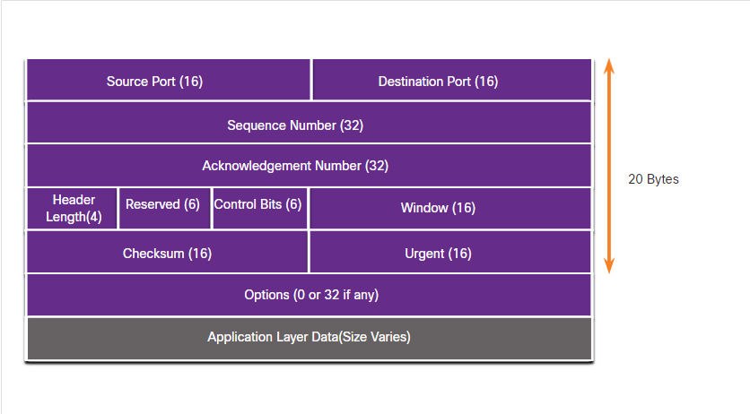
TCP Overview TCP Header
TCP is a stateful protocol which means it keeps track of the state of the communication session.
TCP records which information it has sent, and which information has been acknowledged.
Notes:
14 – Transport Layer
14.2 – TCP Overview
14.2.2 – TCP Header

Slide 12
TCP Overview TCP Header Fields
TCP Header Field | Description
Source Port | A 16-bit field used to identify the source application by port number.
Destination Port | A 16-bit field used to identify the destination application by port number.
Sequence Number | A 32-bit field used for data reassembly purposes.
Acknowledgment Number | A 32-bit field used to indicate that data has been received and the next byte expected from the source.
Header Length | A 4-bit field known as ʺdata offsetʺ that indicates the length of the TCP segment header.
Reserved | A 6-bit field that is reserved for future use.
Control bits | A 6-bit field used that includes bit codes, or flags, which indicate the purpose and function of the TCP segment.
Window size | A 16-bit field used to indicate the number of bytes that can be accepted at one time.
Checksum | A 16-bit field used for error checking of the segment header and data.
Urgent | A 16-bit field used to indicate if the contained data is urgent.
Notes:
14 – Transport Layer
14.2 – TCP Overview
14.2.3 – TCP Header

Slide 13
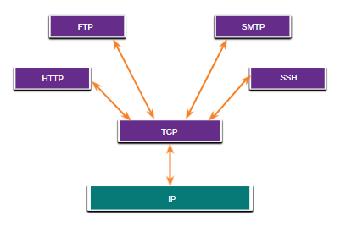
TCP Overview Applications that use TCP
TCP handles all tasks associated with dividing the data stream into segments, providing reliability, controlling data flow, and reordering segments.
Notes:
14 – Transport Layer
14.2 – TCP Overview
14.2.4 – Applications that use TCP
14.2.5 Check your Understanding – TCP Overview

Slide 14
14.3 UDP Overview
Notes:
14 – Transport Layer
14.3 – UDP Overview

Slide 15
UDP Overview UDP Features
UDP features include the following:
Data is reconstructed in the order that it is received.
Any segments that are lost are not resent.
There is no session establishment.
The sending is not informed about resource availability.
Notes:
14 – Transport Layer
14.3 – UDP Overview
14.3.1 – UDP Features

Slide 16
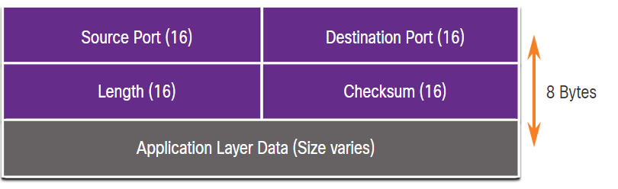
UDP Overview UDP Header
The UDP header is far simpler than the TCP header because it only has four fields and requires 8 bytes (i.e. 64 bits).
UDP Header Field | Description
Source Port | A 16-bit field used to identify the source application by port number.
Destination Port | A 16-bit field used to identify the destination application by port number.
Length | A 16-bit field that indicates the length of the UDP datagram header.
Checksum | A 16-bit field used for error checking of the datagram header and data.
Notes:
14 – Transport Layer
14.3 – UDP Overview
14.3.2 – UDP Header

Slide 17
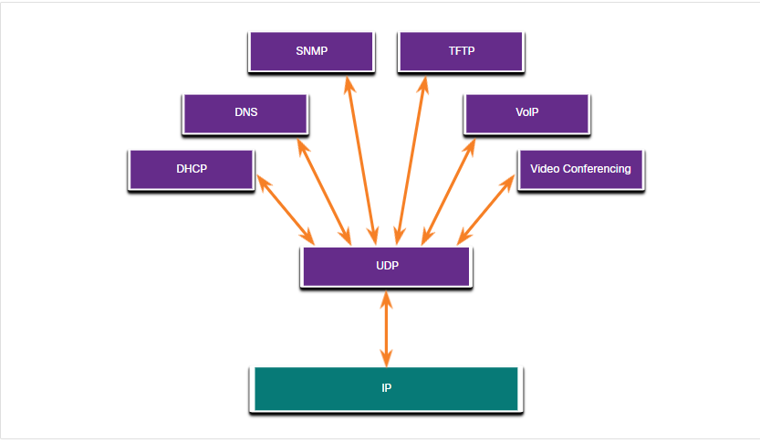
UDP Overview Applications that use UDP
Live video and multimedia applications - These applications can tolerate some data loss but require little or no delay. Examples include VoIP and live streaming video.
Simple request and reply applications - Applications with simple transactions where a host sends a request and may or may not receive a reply. Examples include DNS and DHCP.
Applications that handle reliability themselves - Unidirectional communications where flow control, error detection, acknowledgments, and error recovery is not required, or can be handled by the application. Examples include SNMP and TFTP.
Notes:
14 – Transport Layer
14.3 – UDP Overview
14.3.4 – Applications that use UDP
14.3.5 - Check Your Understanding – UDP Overview

Slide 18
14.4 Port Numbers
Notes:
14 – Transport Layer
14.4 – Port Numbers

Slide 19

Port Numbers Multiple Separate Communications
TCP and UDP transport layer protocols use port numbers to manage multiple, simultaneous conversations.
The source port number is associated with the originating application on the local host whereas the destination port number is associated with the destination application on the remote host.
Notes:
14 – Transport Layer
14.4 – Port Numbers
14.4.1 - Multiple Separate Communications

Slide 20
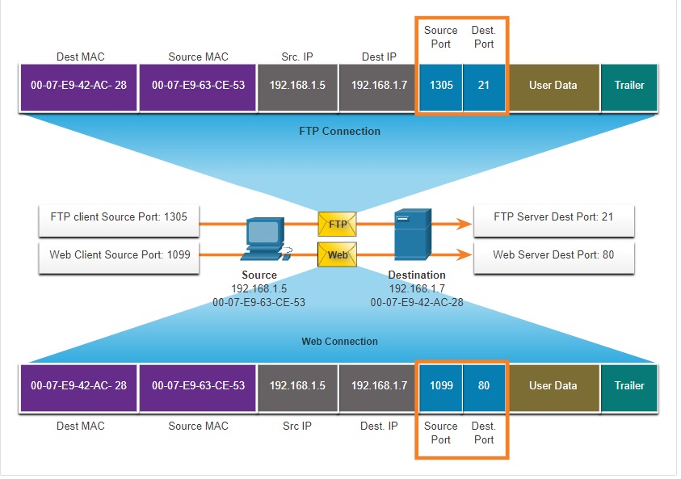
Port numbers Socket Pairs
The source and destination ports are placed within the segment.
The segments are then encapsulated within an IP packet.
The combination of the source IP address and source port number, or the destination IP address and destination port number is known as a socket.
Sockets enable multiple processes, running on a client, to distinguish themselves from each other, and multiple connections to a server process to be distinguished from each other.
Notes:
14 – Transport Layer
14.4 – Port Numbers
14.4.2 – Socket Pairs

Slide 21
Port Numbers Port Number Groups
Port Group | Number Range | Description
Well-known Ports | 0 to 1,023 | These port numbers are reserved for common or popular services and applications such as web browsers, email clients, and remote access clients. Defined well-known ports for common server applications enables clients to easily identify the associated service required.
Registered Ports | 1,024 to 49,151 | These port numbers are assigned by IANA to a requesting entity to use with specific processes or applications. These processes are primarily individual applications that a user has chosen to install, rather than common applications that would receive a well-known port number. For example, Cisco has registered port 1812 for its RADIUS server authentication process.
Private and/or Dynamic Ports | 49,152 to 65,535 | These ports are also known as ephemeral ports. The client’s OS usually assign port numbers dynamically when a connection to a service is initiated. The dynamic port is then used to identify the client application during communication.
Notes:
14 – Transport Layer
14.4 – Port Numbers
14.4.3 - Port Number Groups

Slide 22
Port Numbers Port Number Groups (Cont.)
Well-Known Port Numbers
Port Number | Protocol | Application
20 | TCP | File Transfer Protocol (FTP) - Data
21 | TCP | File Transfer Protocol (FTP) - Control
22 | TCP | Secure Shell (SSH)
23 | TCP | Telnet
25 | TCP | Simple Mail Transfer Protocol (SMTP)
53 | UDP, TCP | Domain Name Service (DNS)
67 | UDP | Dynamic Host Configuration Protocol (DHCP) - Server
68 | UDP | Dynamic Host Configuration Protocol - Client
69 | UDP | Trivial File Transfer Protocol (TFTP)
80 | TCP | Hypertext Transfer Protocol (HTTP)
110 | TCP | Post Office Protocol version 3 (POP3)
143 | TCP | Internet Message Access Protocol (IMAP)
161 | UDP | Simple Network Management Protocol (SNMP)
443 | TCP | Hypertext Transfer Protocol Secure (HTTPS)
Notes:
14 – Transport Layer
14.4 – Port Numbers
14.4.3 - Port Number Groups (Cont.)

Slide 23
Port Numbers The netstat Command
Unexplained TCP connections can pose a major security threat. Netstat is an important tool to verify connections.
C:\> netstat
Active Connections
Proto Local Address Foreign Address State
TCP 192.168.1.124:3126 192.168.0.2:netbios-ssn ESTABLISHED
TCP 192.168.1.124:3158 207.138.126.152:http ESTABLISHED
TCP 192.168.1.124:3159 207.138.126.169:http ESTABLISHED
TCP 192.168.1.124:3160 207.138.126.169:http ESTABLISHED
TCP 192.168.1.124:3161 sc.msn.com:http ESTABLISHED
TCP 192.168.1.124:3166 www.cisco.com:http ESTABLISHED
Notes:
14 – Transport Layer
14.4 – Port Numbers
14.4.4 - The netstat Command
14.4.5 – Check Your Understanding – Port Numbers

Slide 24
14.5 TCP Communication Process
Notes:
14 – Transport Layer
14.5 – TCP Communication Process

Slide 25
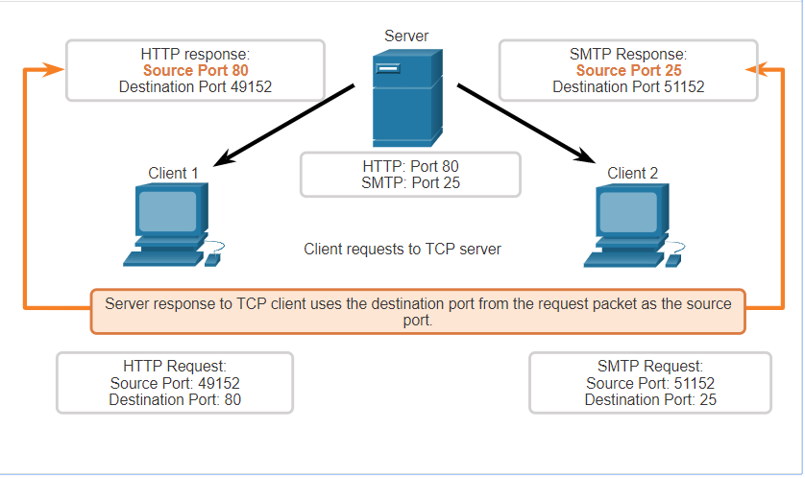
TCP Communication Process TCP Server Processes
Each application process running on a server is configured to use a port number.
An individual server cannot have two services assigned to the same port number within the same transport layer services.
An active server application assigned to a specific port is considered open, which means that the transport layer accepts, and processes segments addressed to that port.
Any incoming client request addressed to the correct socket is accepted, and the data is passed to the server application.
Notes:
14 – Transport Layer
14.5 – TCP Communication Process
14.5.1 – TCP Server Processes

Slide 26
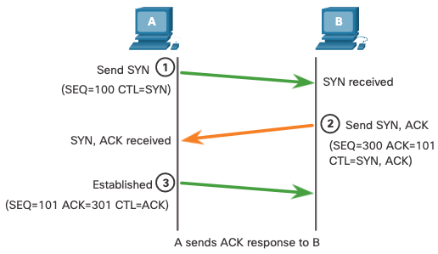
TCP Communication Process TCP Connection Establishment
Step 1: The initiating client requests a client-to-server communication session with the server.
Step 2: The server acknowledges the client-to-server communication session and requests a server-to-client communication session.
Step 3: The initiating client acknowledges the server-to-client communication session.
Notes:
14 – Transport Layer
14.5 – TCP Communication Process
14.5.2 – TCP Connection Establishment

Slide 27
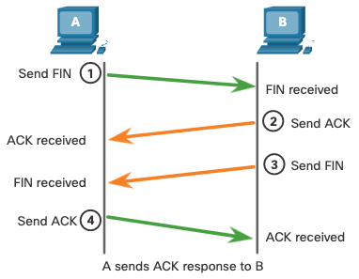
TCP Communication Process Session Termination
Step 1: When the client has no more data to send in the stream, it sends a segment with the FIN flag set.
Step 2: The server sends an ACK to acknowledge the receipt of the FIN to terminate the session from client to server.
Step 3: The server sends a FIN to the client to terminate the server-to-client session.
Step 4: The client responds with an ACK to acknowledge the FIN from the server.
Notes:
14 – Transport Layer
14.5 – TCP Communication Process
14.5.3 – Session Termination

Slide 28
TCP Communication Process TCP Three-Way Handshake Analysis
Functions of the Three-Way Handshake:
It establishes that the destination device is present on the network.
It verifies that the destination device has an active service and is accepting requests on the destination port number that the initiating client intends to use.
It informs the destination device that the source client intends to establish a communication session on that port number.
After the communication is completed the sessions are closed, and the connection is terminated. The connection and session mechanisms enable TCP reliability function.
Notes:
14 – Transport Layer
14.5 – TCP Communication Process
14.5.4 – Three-way Handshake Establishment

Slide 29
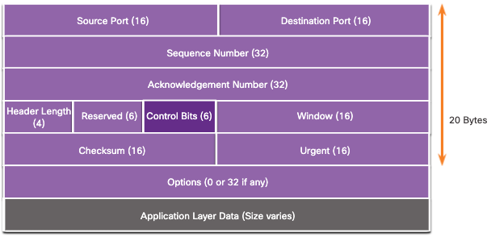
TCP Communication Process TCP Three-Way Handshake Analysis (Cont.)
The six control bit flags are as follows:
URG - Urgent pointer field significant
ACK - Acknowledgment flag used in connection establishment and session termination
PSH - Push function
RST - Reset the connection when an error or timeout occurs
SYN - Synchronize sequence numbers used in connection establishment
FIN - No more data from sender and used in session termination
Notes:
14 – Transport Layer
14.5 – TCP Communication Process
14.5.4 – Three-way Handshake Analysis

Slide 30
14.6 Reliability and Flow Control
Notes:
14 – Transport Layer
14.6 – Reliability and Flow Control

Slide 31
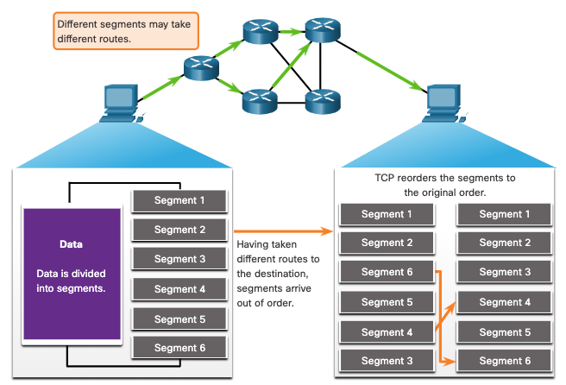
Reliability and Flow Control TCP Reliability- Guaranteed and Ordered Delivery
TCP can also help maintain the flow of packets so that devices do not become overloaded.
There may be times when TCP segments do not arrive at their destination or arrive out of order.
All the data must be received and the data in these segments must be reassembled into the original order.
Sequence numbers are assigned in the header of each packet to achieve this goal.
Notes:
14 – Transport Layer
14.6 – Reliability and Flow Control
14.6.1 – TCP Reliability – Guaranteed and Ordered Delivery

Slide 32
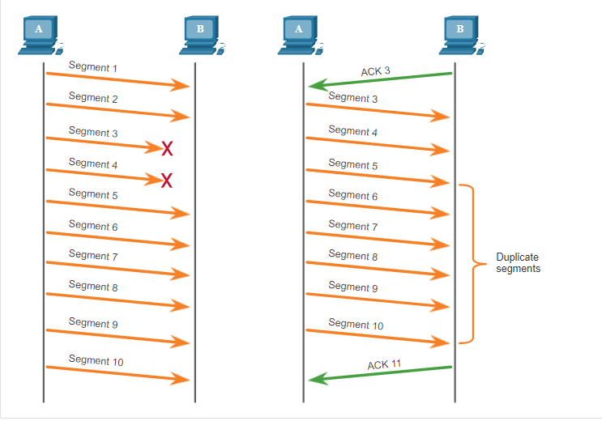
Reliability and Flow Control TCP Reliability – Data Loss and Retransmission
No matter how well designed a network is, data loss occasionally occurs.
TCP provides methods of managing these segment losses. Among these is a mechanism to retransmit segments for unacknowledged data.
Notes:
14 – Transport Layer
14.6 – Reliability and Flow Control
14.6.3 TCP Reliability – Data Loss and Transmission

Slide 33
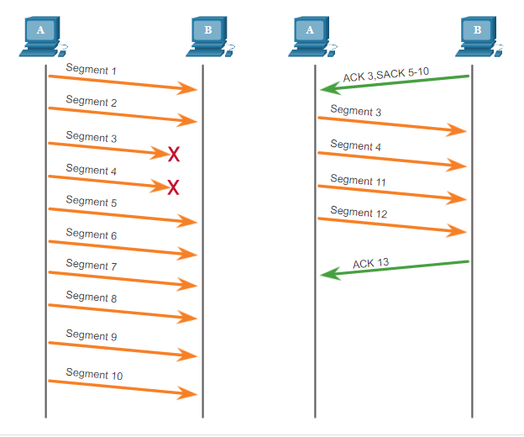
Reliability and Flow Control TCP Reliability – Data Loss and Retransmission (Cont.)
Host operating systems today typically employ an optional TCP feature called selective acknowledgment (SACK), negotiated during the three-way handshake.
If both hosts support SACK, the receiver can explicitly acknowledge which segments (bytes) were received including any discontinuous segments.
Notes:
14 – Transport Layer
14.6 – Reliability and Flow Control
14.6.3 TCP Reliability – Data Loss and Transmission (Cont.)

Slide 34
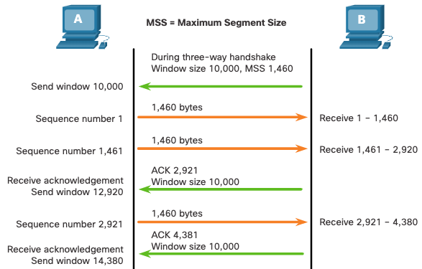
Reliability and Flow Control TCP Flow Control – Window Size and Acknowledgments
TCP also provides mechanisms for flow control as follows:
Flow control is the amount of data that the destination can receive and process reliably.
Flow control helps maintain the reliability of TCP transmission by adjusting the rate of data flow between source and destination for a given session.
Notes:
14 – Transport Layer
14.6 – Reliability and Flow Control
14.6.5 – TCP Flow Control – Window Size and Acknowledgments

Slide 35
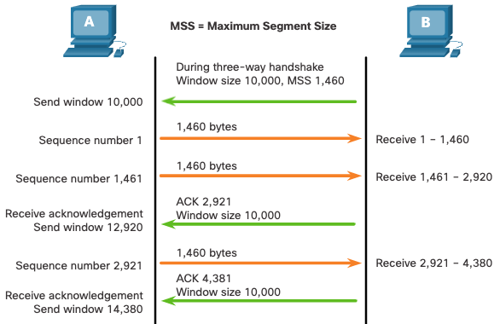
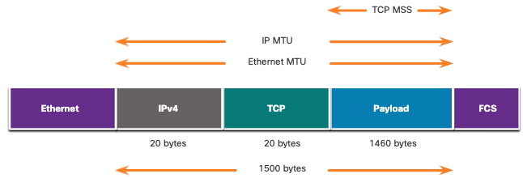
Reliability and Flow Control TCP Flow Control – Maximum Segment Size
Maximum Segment Size (MSS) is the maximum amount of data that the destination device can receive.
A common MSS is 1,460 bytes when using IPv4.
A host determines the value of its MSS field by subtracting the IP and TCP headers from the Ethernet maximum transmission unit (MTU), which is 1500 bytes be default.
1500 minus 40 (20 bytes for the IPv4 header and 20 bytes for the TCP header) leaves 1460 bytes.
Notes:
14 – Transport Layer
14.6 – Reliability and Flow Control
14.6.6 – TCP Flow Control – Maximum Segment Size (MSS)

Slide 36
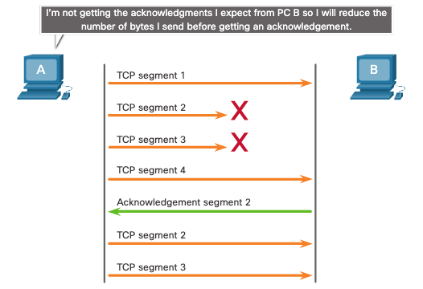
Reliability and Flow Control TCP Flow Control – Congestion Avoidance
When congestion occurs on a network, it results in packets being discarded by the overloaded router.
To avoid and control congestion, TCP employs several congestion handling mechanisms, timers, and algorithms.
Notes:
14 – Transport Layer
14.6 – Reliability and Flow Control
14.6.7 – TCP Flow Control – Congestion Avoidance
14.6.8 – Check you Understanding – Reliability and Flow Control

Slide 37
14.7 UDP Communication
Notes:
14 – Transport Layer
14.7 UDP Communication

Slide 38
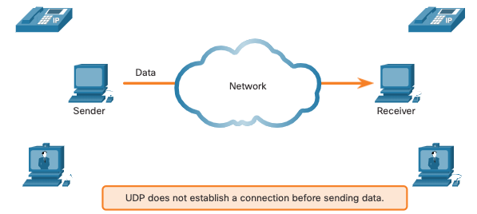
UDP Communication UDP Low Overhead versus Reliability
UDP does not establish a connection. UDP provides low overhead data transport because it has a small datagram header and no network management traffic.
Notes:
14 – Transport Layer
14.7 - UDP Communication
14.7.1 - UDP Low Overhead versus Reliability

Slide 39
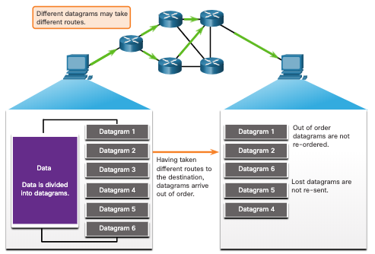
UDP Communication UDP Datagram Reassembly
UDP does not track sequence numbers the way TCP does.
UDP has no way to reorder the datagrams into their transmission order.
UDP simply reassembles the data in the order that it was received and forwards it to the application.
Notes:
14 – Transport Layer
14.7 - UDP Communication
14.7.2 – UDP Datagram Reassembly

Slide 40
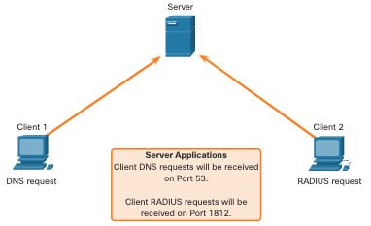
UDP Communication UDP Server Processes and Requests
UDP-based server applications are assigned well-known or registered port numbers.
UDP receives a datagram destined for one of these ports, it forwards the application data to the appropriate application based on its port number.
Notes:
14 – Transport Layer
14.7 - UDP Communication
14.7.3 – UDP Server Processes and Requests

Slide 41
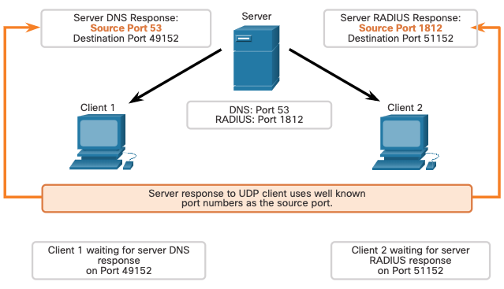
UDP Communication UDP Client Processes
The UDP client process dynamically selects a port number from the range of port numbers and uses this as the source port for the conversation.
The destination port is usually the well-known or registered port number assigned to the server process.
After a client has selected the source and destination ports, the same pair of ports are used in the header of all datagrams in the transaction.
Notes:
14 – Transport Layer
14.7 - UDP Communication
14.7.4 – UDP Client Processes
14.7.5 Check Your Understanding – UDP Communication

Slide 42
Module 15: Application Layer
Introduction to Networks v7.0 (ITN)
Notes:
Cisco Networking Academy Program
Introduction to Networks v7.0 (ITN)
Module 15: Application Layer

Slide 43
15.1 Application, Presentation, and Session
Notes:
15 – Application Layer
15.1 – Application, Presentation, and Session

Slide 44
Application, Presentation, and Session Application Layer
The upper three layers of the OSI model (application, presentation, and session) define functions of the TCP/IP application layer.
The application layer provides the interface between the applications used to communicate, and the underlying network over which messages are transmitted.
Some of the most widely known application layer protocols include HTTP, FTP, TFTP, IMAP and DNS.
Notes:
15 – Application Layer
15.1 – Application, Presentation, and Session
15.1.1 – Application Layer

Slide 45
Application, Presentation, and Session Presentation and Session Layer
The presentation layer has three primary functions:
Formatting, or presenting, data at the source device into a compatible format for receipt by the destination device
Compressing data in a way that can be decompressed by the destination device
Encrypting data for transmission and decrypting data upon receipt
The session layer functions:
It creates and maintains dialogs between source and destination applications.
It handles the exchange of information to initiate dialogs, keep them active, and to restart sessions that are disrupted or idle for a long period of time.
Notes:
15 – Application Layer
15.1 – Application, Presentation, and Session
15.1.2 – Presentation and Session Layer

Slide 46
Application, Presentation, and Session TCP/IP Application Layer Protocols
The TCP/IP application protocols specify the format and control information necessary for many common internet communication functions.
Application layer protocols are used by both the source and destination devices during a communication session.
For the communications to be successful, the application layer protocols that are implemented on the source and destination host must be compatible.
Name System
DNS - Domain Name System (or Service)
TCP, UDP client 53
Translates domain names, such as cisco.com, into IP addresses.
Host Config
DHCP - Dynamic Host Configuration Protocol
UDP client 68, server 67
Dynamically assigns IP addresses to be re-used when no longer needed
Web
HTTP - Hypertext Transfer Protocol
TCP 80, 8080
A set of rules for exchanging text, graphic images, sound, video, and other multimedia files on the World Wide Web
Notes:
15 – Application Layer
15.1 – Application, Presentation, and Session
15.1.3 – TCP/IP Application Layer Protocols
15.1.4 – Check Your Understanding – Application, Session, Presentation

Slide 47
15.2 Peer-to-Peer
Notes:
15 – Application Layer
15.2 – Peer-to-Peer

Slide 48
Peer-to-Peer Client-Server Model
Client and server processes are considered to be in the application layer.
In the client/server model, the device requesting the information is called a client and the device responding to the request is called a server.
Application layer protocols describe the format of the requests and responses between clients and servers.
Notes:
15 – Application Layer
15.2 – Peer-to-Peer
15.2.1 – Client-Server Model

Slide 49
Peer-to-Peer Peer-to-Peer Networks
In a peer-to-peer (P2P) network, two or more computers are connected via a network and can share resources (such as printers and files) without having a dedicated server.
Every connected end device (known as a peer) can function as both a server and a client.
One computer might assume the role of server for one transaction while simultaneously serving as a client for another. The roles of client and server are set on a per request basis.
Notes:
15 – Application Layer
15.2 – Peer-to-Peer
15.2.2 – Peer-to-Peer Networks

Slide 50
Peer-to-Peer Peer-to-Peer Applications
A P2P application allows a device to act as both a client and a server within the same communication.
Some P2P applications use a hybrid system where each peer accesses an index server to get the location of a resource stored on another peer.
Notes:
15 – Application Layer
15.2 – Peer-to-Peer
15.2.3 – Peer-to-Peer Applications

Slide 51
Peer-to-Peer Common P2P Applications
With P2P applications, each computer in the network that is running the application can act as a client or a server for the other computers in the network that are also running the application.
Common P2P networks include the following:
BitTorrent
Direct Connect
eDonkey
Freenet
Notes:
15 – Application Layer
15.2 – Peer-to-Peer
15.2.4 – Common P2P Applications
15.2.5 – Check Your Understanding – Peer-to-Peer

Slide 52
15.3 Web and Email Protocols
Notes:
15 – Application Layer
15.3 – Web and Email Protocols

Slide 53
Web and Email Protocols Hypertext Transfer Protocol and Hypertext Markup Language
When a web address or Uniform Resource Locator (URL) is typed into a web browser, the web browser establishes a connection to the web service. The web service is running on the server that is using the HTTP protocol.
To better understand how the web browser and web server interact, examine how a web page is opened in a browser.
Step 1
The browser interprets the three parts of the URL:
http (the protocol or scheme)
www.cisco.com (the server name)
index.html (the specific filename requested)
Notes:
15 – Application Layer
15.3 – Web and Email Protocols
15.3.1 – Hypertext Transfer Protocol and Hypertext Markup Language

Slide 54
Web and Email Protocols Hypertext Transfer Protocol and Hypertext Markup Language (Cont.)
Step 2
The browser then checks with a name server to convert www.cisco.com into a numeric IP address, which it uses to connect to the server.
The client initiates an HTTP request to a server by sending a GET request to the server and asks for the index.html file.
Step 3
In response to the request, the server sends the HTML code for this web page to the browser.
Notes:
15 – Application Layer
15.3 – Web and Email Protocols
15.3.1 – Hypertext Transfer Protocol and Hypertext Markup Language (Cont.)

Slide 55
Web and Email Protocols Hypertext Transfer Protocol and Hypertext Markup Language (Cont.)
Step 4
The browser deciphers the HTML code and formats the page for the browser window.
Notes:
15 – Application Layer
15.3 – Web and Email Protocols
15.3.1 – Hypertext Transfer Protocol and Hypertext Markup Language (Cont.)

Slide 56
Web and Email Protocols HTTP and HTTPS
HTTP is a request/response protocol that specifies the message types used for that communication.
The three common message types are GET, POST, and PUT:
GET - This is a client request for data. A client (web browser) sends the GET message to the web server to request HTML pages.
POST - This uploads data files to the web server, such as form data.
PUT - This uploads resources or content to the web server, such as an image.
Note: HTTP is not a secure protocol. For secure communications sent across the internet, HTTPS should be used.
Notes:
15 – Application Layer
15.3 – Web and Email Protocols
15.3.2 – HTTP and HTTPS

Slide 57
Web and Email Protocols Email Protocols
Email is a store-and-forward method of sending, storing, and retrieving electronic messages across a network. Email messages are stored in databases on mail servers. Email clients communicate with mail servers to send and receive email.
The email protocols used for operation are:
Simple Mail Transfer Protocol (SMTP) – used to send mail.
Post Office Protocol (POP) & IMAP – used for clients to receive mail.
Notes:
15 – Application Layer
15.3 – Web and Email Protocols
15.3.3 – Email Protocols

Slide 58
Web and Email Protocols SMTP, POP and IMAP
When a client sends email, the client SMTP process connects with a server SMTP process on well-known port 25.
After the connection is made, the client attempts to send the email to the server across the connection.
When the server receives the message, it either places the message in a local account, if the recipient is local, or forwards the message to another mail server for delivery.
The destination email server may not be online or may be busy. If so, SMTP spools messages to be sent at a later time.
Note: SMTP message formats require a message header (recipient email address & sender email address) and a message body.
Notes:
15 – Application Layer
15.3 – Web and Email Protocols
15.3.4 – SMTP, POP and IMAP

Slide 59
Web and Email Protocols SMTP, POP and IMAP (Cont.)
POP is used by an application to retrieve mail from a mail server. When mail is downloaded from the server to the client using POP the messages are then deleted on the server.
The server starts the POP service by passively listening on TCP port 110 for client connection requests.
When a client wants to make use of the service, it sends a request to establish a TCP connection with the server.
When the connection is established, the POP server sends a greeting.
The client and POP server then exchange commands and responses until the connection is closed or aborted.
Note: Since POP does not store messages, it is not recommended for small businesses that need a centralized backup solution.
Notes:
15 – Application Layer
15.3 – Web and Email Protocols
15.3.4 – SMTP, POP and IMAP (Cont.)

Slide 60
Web and Email Protocols SMTP, POP and IMAP (Cont.)
IMAP is another protocol that describes a method to retrieve email messages.
Unlike POP, when a user connects to an IMAP server, copies of the messages are downloaded to the client application. The original messages are kept on the server until manually deleted.
When a user decides to delete a message, the server synchronizes that action and deletes the message from the server.
Notes:
15 – Application Layer
15.3 – Web and Email Protocols
15.3.4 – SMTP, POP and IMAP (Cont.)
15.3.5 – Check Your Understanding – Web and Email Protocols

Slide 61
15.4 IP Addressing Services
Notes:
15 – Application Layer
15.4 – IP Addressing Services

Slide 62
IP Addressing Services Domain Name Service
Domain names were created to convert the numeric IP addresses into a simple, recognizable name.
Fully-qualified domain names (FQDNs), such as http://www.cisco.com, are much easier for people to remember than 198.133.219.25.
The DNS protocol defines an automated service that matches resource names with the required numeric network address. It includes the format for queries, responses, and data.
Notes:
15 – Application Layer
15.4 – IP Addressing Services
15.4.1 – Domain Name Service

Slide 63
IP Addressing Services DNS Message Format
The DNS server stores different types of resource records that are used to resolve names. These records contain the name, address, and type of record.
Some of these record types are as follows:
A - An end device IPv4 address
NS - An authoritative name server
AAAA - An end device IPv6 address (pronounced quad-A)
MX - A mail exchange record
When a client makes a query, the server DNS process first looks at its own records to resolve the name. If it is unable to resolve the name by using its stored records, it contacts other servers to resolve the name.
After a match is found and returned to the original requesting server, the server temporarily stores the numbered address in the event that the same name is requested again.
Notes:
15 – Application Layer
15.4 – IP Addressing Services
15.4.2 – DNS Message Format

Slide 64
IP Addressing Services DNS Message Format (Cont.)
DNS uses the same message format between servers, consisting of a question, answer, authority, and additional information for all types of client queries and server responses, error messages, and transfer of resource record information.
DNS message section | Description
Question | The question for the name server
Answer | Resource Records answering the question
Authority | Resource Records pointing toward an authority
Additional | Resource Records holding additional information
Notes:
15 – Application Layer
15.4 – IP Addressing Services
15.4.2 – DNS Message Format (Cont.)

Slide 65
IP Addressing Services DNS Hierarchy
DNS uses a hierarchical system to create a database to provide name resolution.
Each DNS server maintains a specific database file and is only responsible for managing name-to-IP mappings for that small portion of the entire DNS structure.
When a DNS server receives a request for a name translation that is not within its DNS zone, the DNS server forwards the request to another DNS server within the proper zone for translation.
Examples of top-level domains:
.com - a business or industry
.org - a non-profit organization
.au - Australia
Notes:
15 – Application Layer
15.4 – IP Addressing Services
15.4.3 – DNS Hierarchy

Slide 66
IP Addressing Services The nslookup Command
Nslookup is a computer operating system utility that allows a user to manually query the DNS servers configured on the device to resolve a given host name.
This utility can also be used to troubleshoot name resolution issues and to verify the current status of the name servers.
When the nslookup command is issued, the default DNS server configured for your host is displayed.
The name of a host or domain can be entered at the nslookup prompt.
Notes:
15 – Application Layer
15.4 – IP Addressing Services
15.4.4 – The nslookup Command
15.4.5 – Syntax Checker – The nslookup Command

Slide 67
IP Addressing Services Dynamic Host Configuration Protocol
The Dynamic Host Configuration Protocol (DHCP) for IPv4 service automates the assignment of IPv4 addresses, subnet masks, gateways, and other IPv4 networking parameters.
DHCP is considered dynamic addressing compared to static addressing. Static addressing is manually entering IP address information.
When a host connects to the network, the DHCP server is contacted, and an address is requested. The DHCP server chooses an address from a configured range of addresses called a pool and assigns (leases) it to the host.
Many networks use both DHCP and static addressing. DHCP is used for general purpose hosts, such as end user devices. Static addressing is used for network devices, such as gateway routers, switches, servers, and printers.
Note: DHCP for IPv6 (DHCPv6) provides similar services for IPv6 clients. However, DHCPv6 does not provide a default gateway address. This can only be obtained dynamically from the Router Advertisement message of the router.
Notes:
15 – Application Layer
15.4 – IP Addressing Services
15.4.6 – Dynamic Host Configuration Protocol

Slide 68
IP Addressing Services DHCP Operation
The DHCP Process:
When an IPv4, DHCP-configured device boots up or connects to the network, the client broadcasts a DHCP discover (DHCPDISCOVER) message to identify any available DHCP servers on the network.
A DHCP server replies with a DHCP offer (DHCPOFFER) message, which offers a lease to the client. (If a client receives more than one offer due to multiple DHCP servers on the network, it must choose one.)
The client sends a DHCP request (DHCPREQUEST) message that identifies the explicit server and lease offer that the client is accepting.
The server then returns a DHCP acknowledgment (DHCPACK) message that acknowledges to the client that the lease has been finalized.
If the offer is no longer valid, then the selected server responds with a DHCP negative acknowledgment (DHCPNAK) message and the process must begin with a new DHCPDISCOVER message.
Note: DHCPv6 has a set of messages that is similar to those for DHCPv4. The DHCPv6 messages are SOLICIT, ADVERTISE, INFORMATION REQUEST, and REPLY.
Notes:
15 – Application Layer
15.4 – IP Addressing Services
15.4.7 – DHCP Operation

Slide 69
15.5 File Sharing Services
Notes:
15 – Application Layer
15.5 – File Sharing Services

Slide 70
File Sharing Services File Transfer Protocol
FTP was developed to allow for data transfers between a client and a server. An FTP client is an application which runs on a computer that is being used to push and pull data from an FTP server.
Step 1 - The client establishes the first connection to the server for control traffic using TCP port 21. The traffic consists of client commands and server replies.
Step 2 - The client establishes the second connection to the server for the actual data transfer using TCP port 20. This connection is created every time there is data to be transferred.
Step 3 - The data transfer can happen in either direction. The client can download (pull) data from the server, or the client can upload (push) data to the server.
Notes:
15 – Application Layer
15.5 – File Sharing Services
15.5.1 – File Transfer Protocol

Slide 71
File Sharing Services Server Message Block
The Server Message Block (SMB) is a client/server, request-response file sharing protocol. Servers can make their own resources available to clients on the network.
Three functions of SMB messages:
Start, authenticate, and terminate sessions
Control file and printer access
Allow an application to send or receive messages to or from another device
Unlike the file sharing supported by FTP, clients establish a long-term connection to servers. After the connection is established, the user of the client can access the resources on the server as though the resource is local to the client host.
Notes:
15 – Application Layer
15.5 – File Sharing Services
15.5.2 – Server Message Block
15.5.3 – Check Your Understanding – File Sharing Services

